Slide 1

Tableau
Tushar B. Kute
https://tusharkute.com

Slide 2

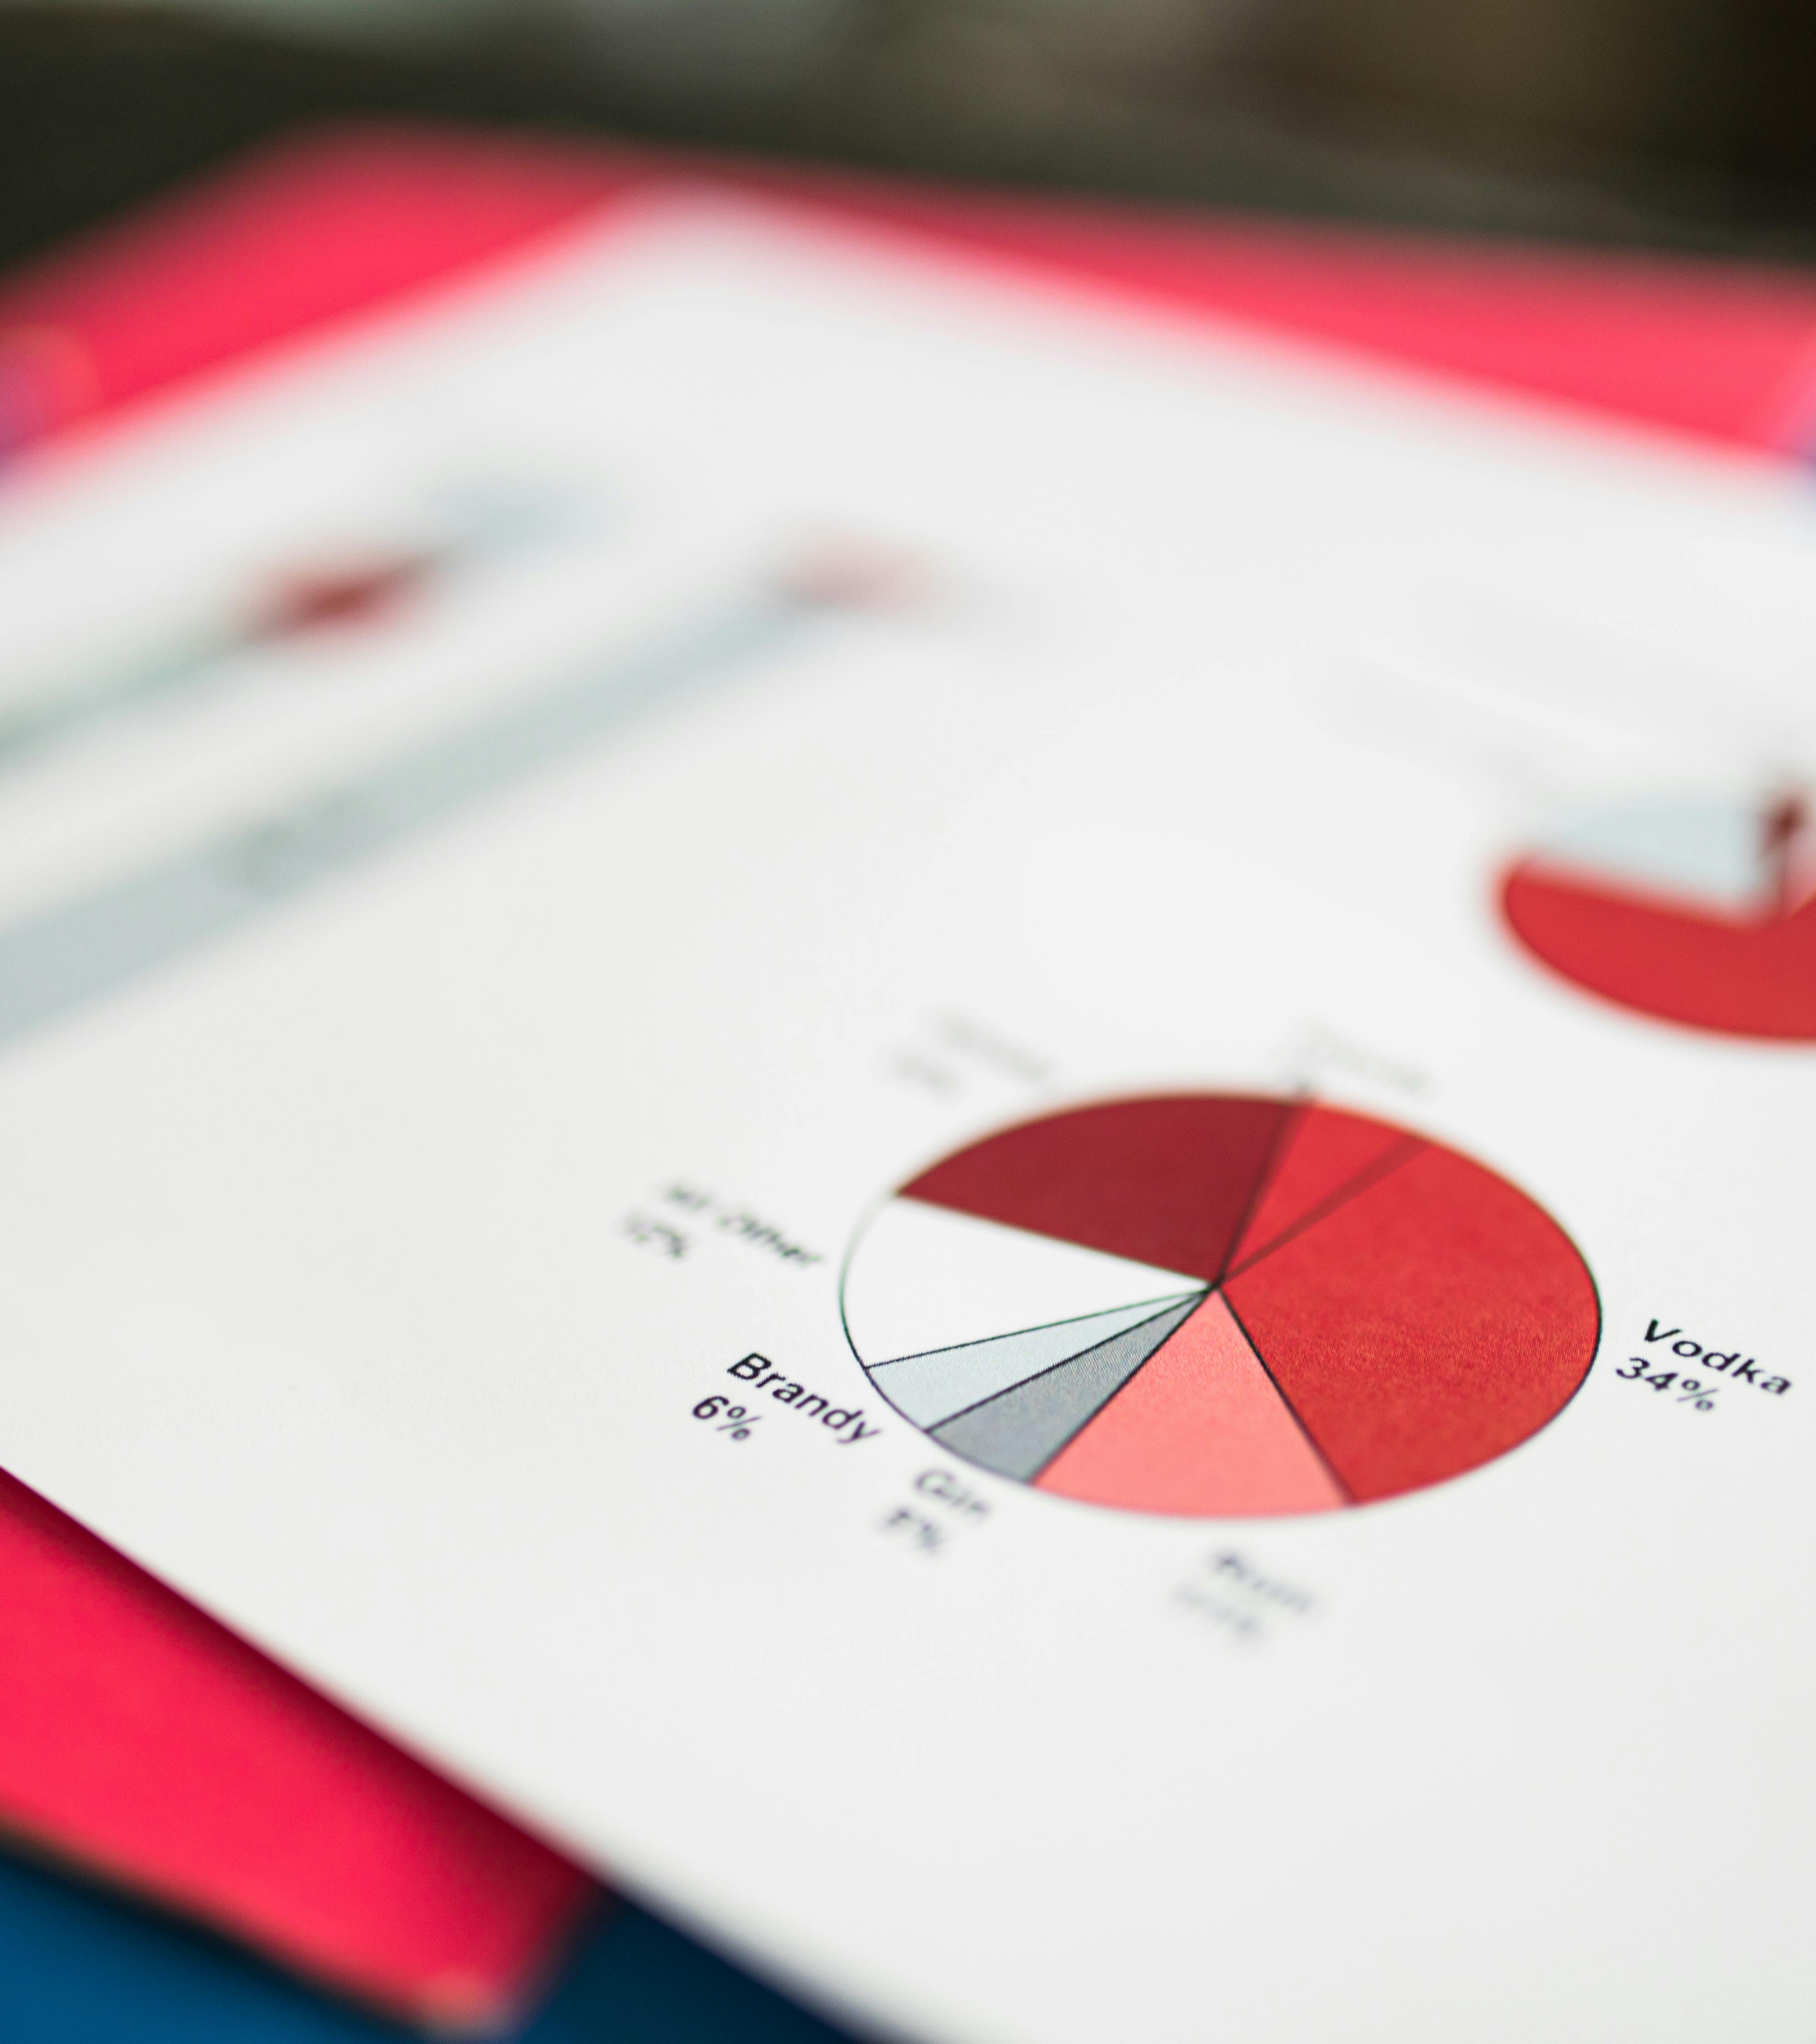

What is Data Visualization?
Data visualization is the representation of data through use of common graphics, such as charts, plots, infographics, and even animations.
Benefits
Simplifies complex information
Identifies patterns and trends
Enhances decision-making

Slide 3

What is Tableau?
Tableau is a powerful data visualization tool used to analyze, visualize, and present data
It allows users to create interactive and dynamic dashboards, reports, and graphics

Slide 4
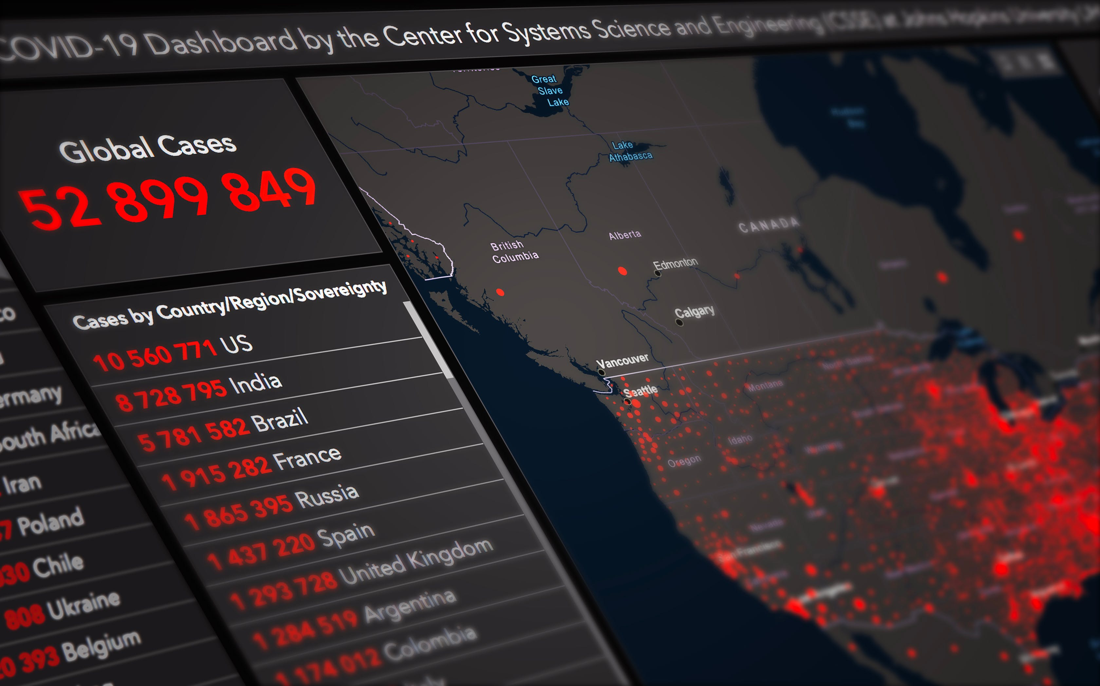
Key Features of Tableau
Drag-and-drop functionality for easy data manipulation
Wide variety of visualization options, including charts, graphs, maps, and more
Ability to connect to various data sources, both structured and unstructured
Interactive filters and parameters for real-time data exploration
Tableau enables users to create visually appealing and interactive dashboards, charts, and graphs.

Slide 5

Benefits of Using Tableau
Enhanced data-driven decision-making
Quick and easy data analysis and visualization
Improved data accuracy and quality
Increased efficiency and productivity

Slide 6
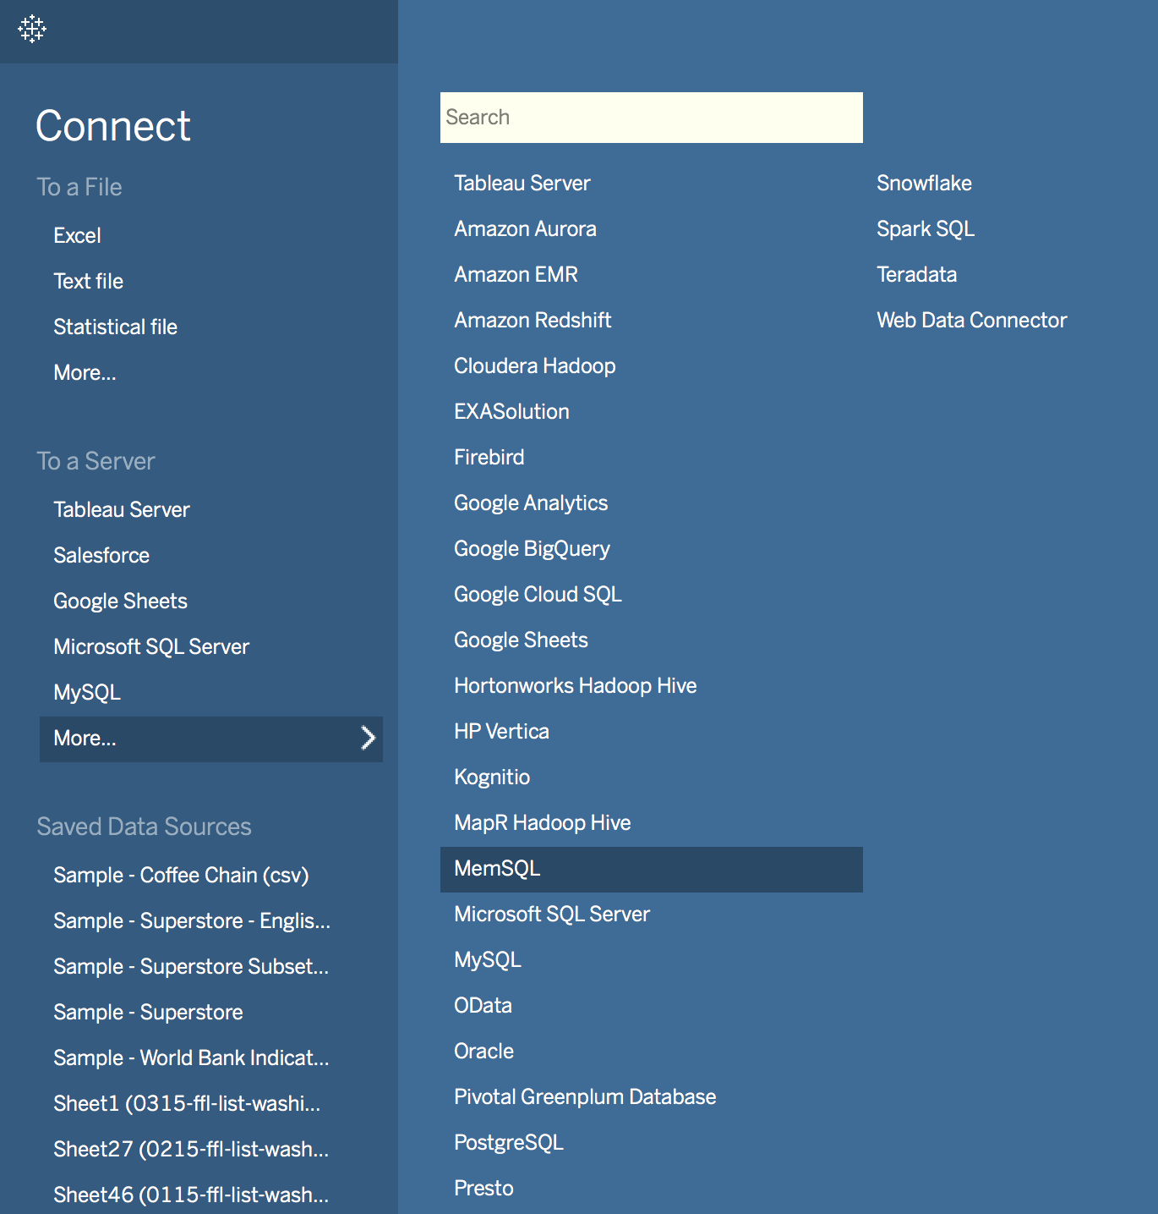
Exploring Tableau's Connection Options
Tableau offers versatile connectivity options to various data sources.
1. File Connectors: Connect to Excel, CSV, JSON, and other file formats.
2. Database Connectors: Connect to popular databases like MySQL, Oracle, and SQL Server.
3. Web Data Connectors: Access data from web services and APIs.
4. Cloud Connectors: Connect to cloud-based data sources like Google Analytics and Salesforce.
5. Big Data Connectors: Work with data stored in Hadoop, Spark, and other big data platforms.

Slide 7

Understanding Tableau's User Interface
Tableau is a powerful data visualization tool.
The user interface consists of various elements that allow users to interact with the software.

Slide 8
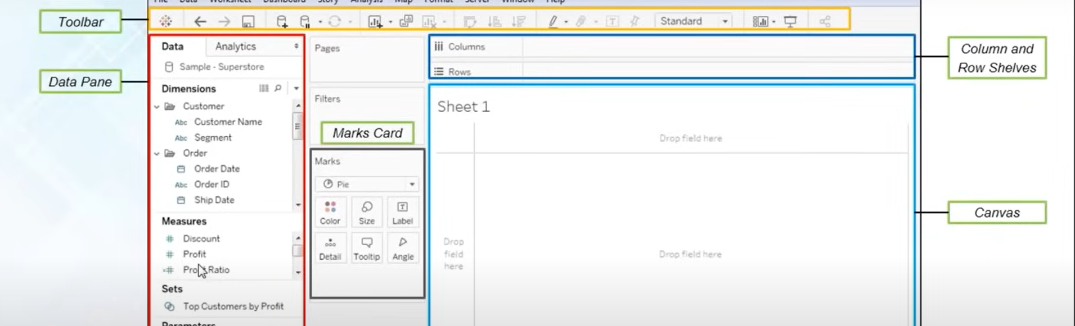
Key Elements of Tableau's User Interface
1. Menu Bar: Provides access to various commands and tools.
2. Toolbar: Contains frequently used actions and shortcuts.
3. Data Pane: Displays the data sources and fields used in the workbook.
4. Worksheet: The main area where data visualization is created.
5. Sheets and Dashboards: Allows the organization and arrangement of multiple visualizations.

Slide 9
Key Elements of Tableau's User Interface
6. Show Me: Provides different visualization options based on the data.
7. Filters and Parameters: Enable data filtering and interactive control.
8. Legends and Color Palettes: Help interpret data and apply color schemes.
9. Analytics Pane: Offers various statistical and analytical functions.

Slide 10

Understanding Dimensions
Dimensions in Tableau represent categorical data
A dimension is a field that is an independent variable
They provide context and structure to your analysis

Slide 11
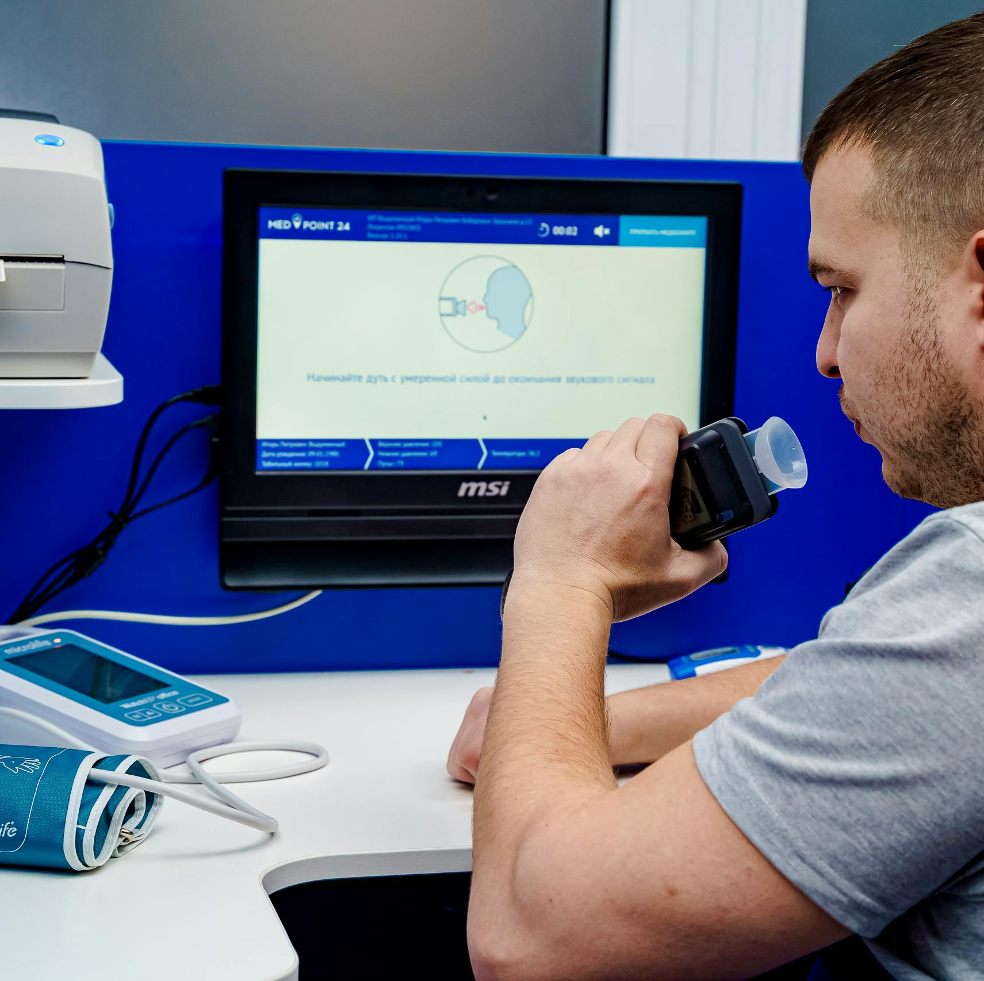
Exploring Measures
Measures in Tableau represent numerical data
It is a field that is a dependent variable and its value is a function of one or more dimensions.
They allow you to perform calculations and aggregations

Slide 12

Data Visualizations
Bar charts
Line charts
Pie charts
Scatter plots
Maps
Heat maps
Tree maps

Slide 13
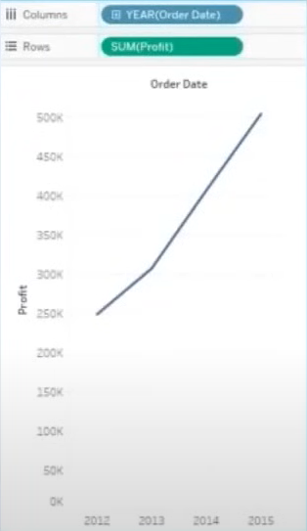
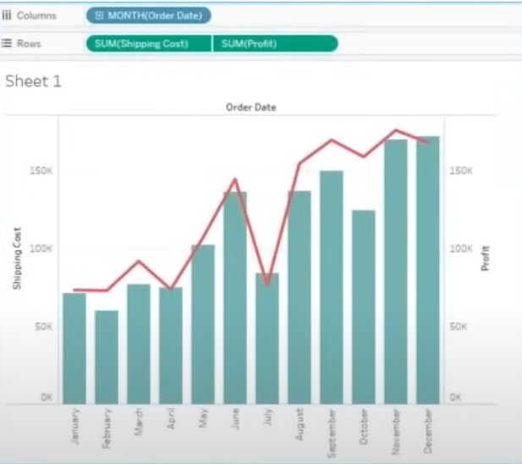
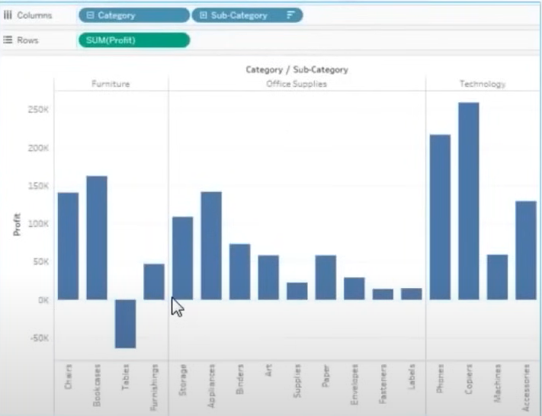
Line Graph
Dual Axes Graph
Bar Graph

Slide 14
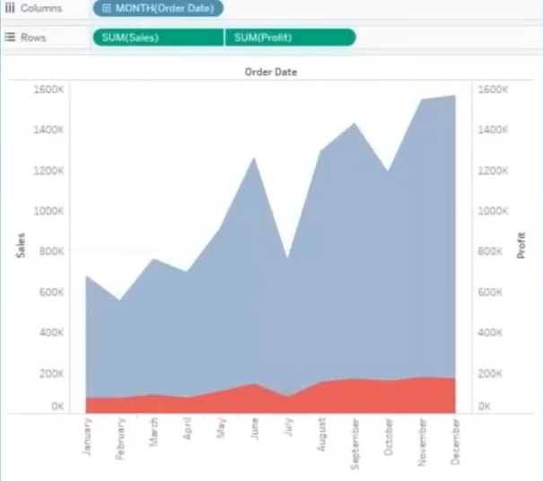
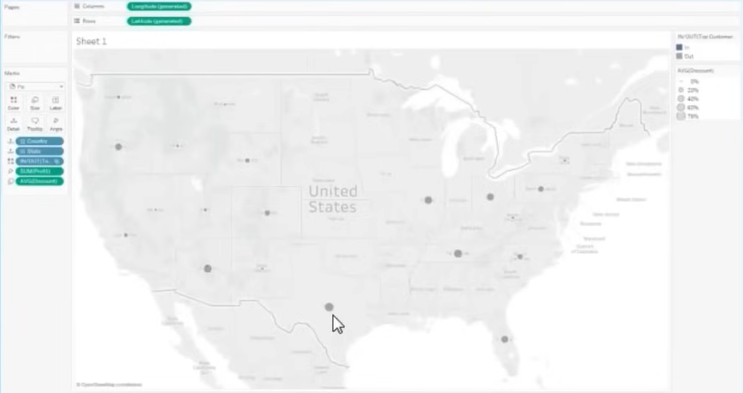
Geographical Graph
Area Graph with Dual Axes

Slide 15
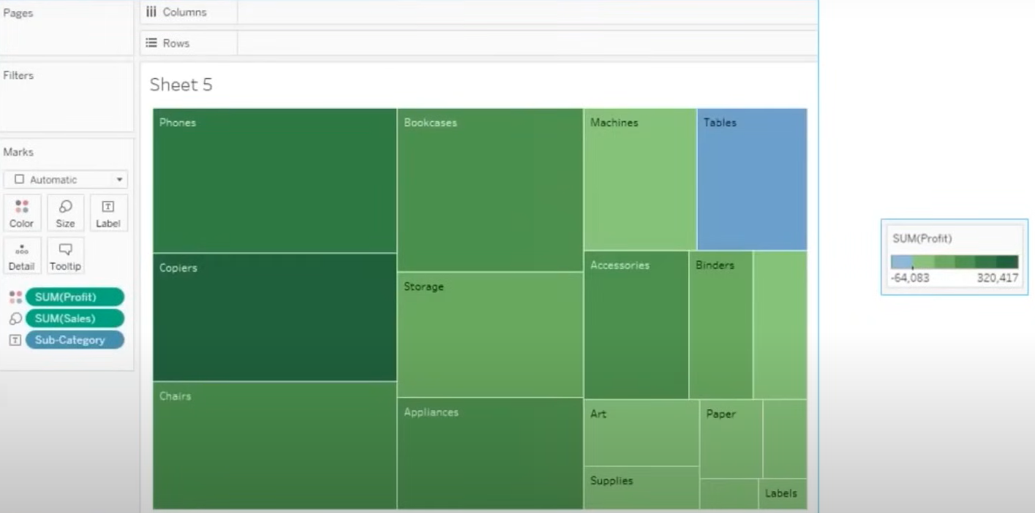
Tree map

Slide 16
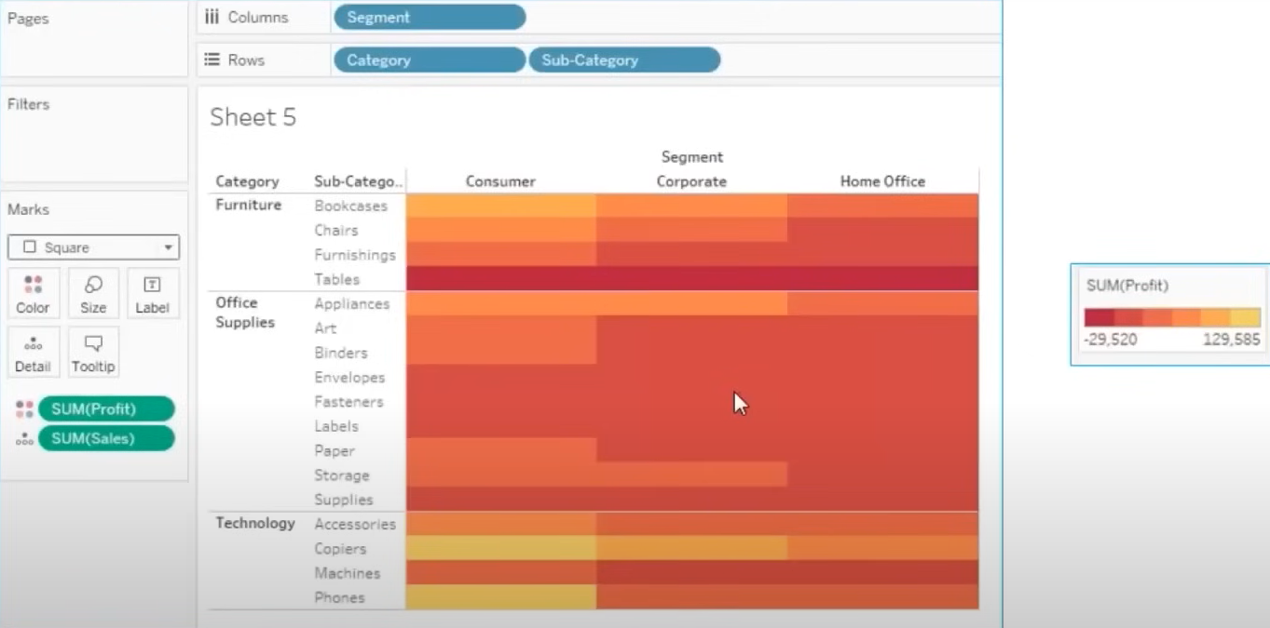
Heat Map

Slide 17
VISUALIZATION | APPLICATION
Bar Graph | When dimension is continuous
Dual Axis Graph | For continuous dimensions
Line Graph | To represent two measures together
Area Graph (Dual Axes) | Provides better comparison amongst measures
Geographical graph | To plot measures on geographical map
Heat Map | To visualize variations between categories
Tree Map | To represent quantity in nested rectangles

Slide 18

Best Practices for Data Visualization
Simplify and declutter
Use appropriate color schemes
Ensure data accuracy and quality
Provide clear labels and titles
Highlight key insights

Slide 19








Thank You
/mITuSkillologies
@mitu_group
/company/mitu- MITUSkillologies
skillologies
Web Resources https://mitu.co.in http://tusharkute.com
@mituskillologies
@mituskillologies
contact@mitu.co.in
tushar@tusharkute.com

